Slide 1
CMSC201 Computer Science I for Majors Lecture 08 – Lists

Slide 2
Last Class We Covered
Constants
More on while loops
Sentinel loops
Boolean flags

Slide 3
Any Questions from Last Time?

Slide 4
Today’s Objectives
To learn about lists and what they are used for
To be able to create and update lists
To learn different ways to mutate a list
append()
remove()
To understand the syntax of lists
To be able to use the membership “in” operator

Slide 5
Note on Loop Evaluations
The conditional in a while loop is not checked until the body of the loop has finished
How many times will this code print “Hello”?
count = 0
while count < 4:
count += 1
print("Hello")
“Hello” will be printed out four times
The loop does NOT stop as soon as count’s value is changed to 4

Slide 6
Introduction to Lists

Slide 7
Exercise: Average Three Numbers
Read in three numbers and average them
num1 = int(input("Please enter a number: "))
num2 = int(input("Please enter a number: "))
num3 = int(input("Please enter a number: "))
print((num1 + num2 + num3) / 3)
Easy! But what if we want to do 100 numbers? Or 1000 numbers?
Do we want to make 1000 variables?

Slide 8
Using Lists
We need an easy way to hold individual data items without needing to make lots of variables
Making num1, num2, ..., num99, num100 is time-consuming and impractical
Instead, we can use a list to hold our data
A list is a data structure: something that holds multiple pieces of data in one structure

Slide 9
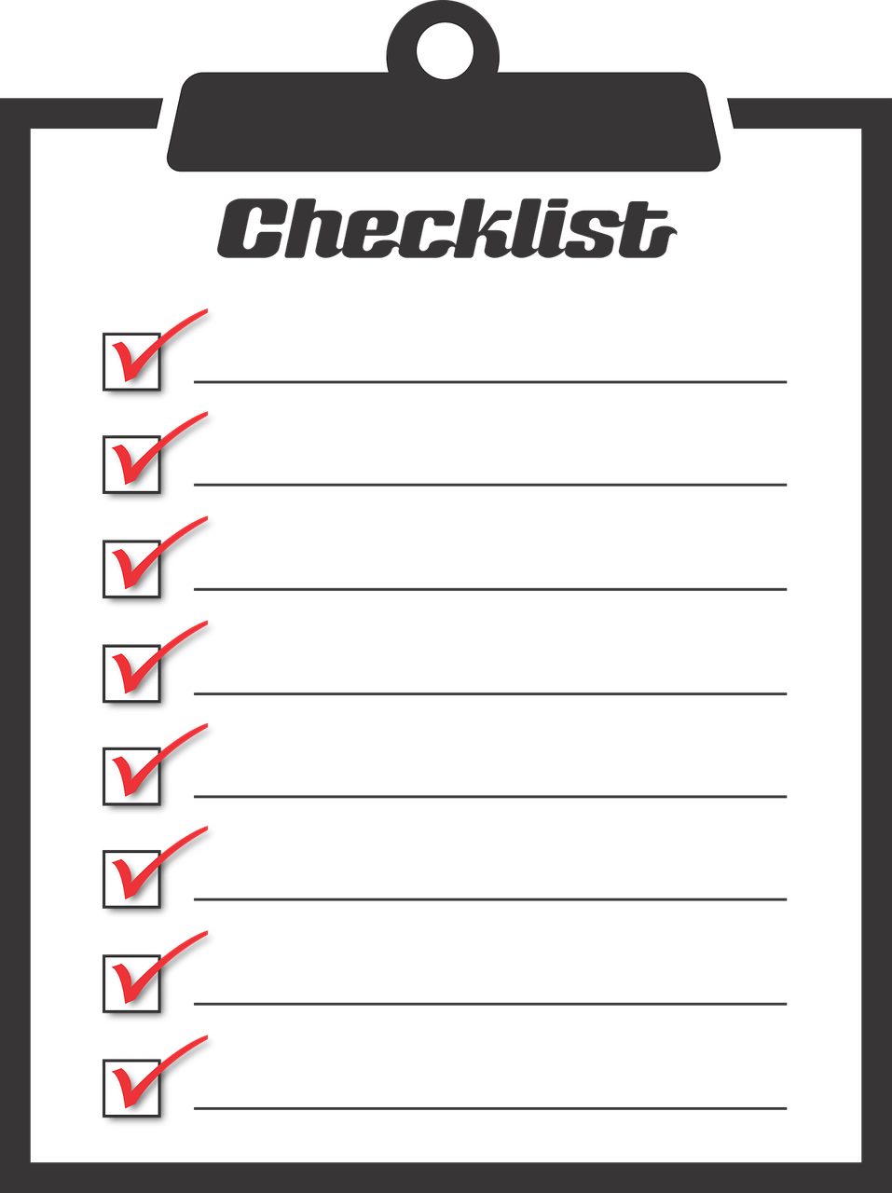
Lists vs Individual Variables
Individual variables are like sticky notes
Work best when you only need a few
Good for storing different “pieces” of info
Lists are like a checklist written on a single piece of paper
Best for storing a lot of related information together

Slide 10
Properties of a List
Heterogeneous (multiple data types!)
Contiguous (all together in memory)
Ordered (numbered from 0 to n-1)
Have instant (“random”) access to any element
Are “mutable sequences of arbitrary objects”

Slide 11
Creating and Modifying Lists

Slide 12
Creating an Empty List
To create an empty list, use square brackets:
newList = []
This creates a list variable called newList, with no elements in the list
(Sort of like a new checklist on a blank page)
Similar to how we create an empty string:
newString = ""

Slide 13
List Function: append()
The append() function lets us add items to the end of a list, increasing its size
listName.append(itemToAppend)
Useful for creating a list from flexible input
Can start with an empty list, and add items as the user requests

Slide 14
Example of append()
We can use append() to create a list of numbers (using a loop to control how many)
values = [] # initialize the list to be empty
count = 0 # count how many numbers added
while count < 10:
userVal = int(input("Enter a number: "))
# add value to the list
values.append(userVal)
count += 1

Slide 15
Here’s a demonstration of what the code is doing
bash-4.1$ python numberList.py
Enter a number: 17
Enter a number: 22
Enter a number: 5
Enter a number: -6
17
22
5
-6
values = [] # initialize empty list
count = 0
while count < 10:
userVal = int(input("Enter a number: "))
values.append(userVal)
count += 1

Slide 16
List Function: remove()
The remove() function lets us remove an item from the list – specifically, it finds and removes the first instance of a given value
listName.remove( valueToRemove )
Useful for deleting things we don’t need
(We won’t use it very much in CMSC 201 though)

Slide 17
Example of remove()
We can use remove() to remove students who have dropped the class from the roster
roster = ["Adam", "Alice", "Andy", "Ariel"]
Adam
Alice
Andy
Ariel
roster =

Slide 18
Example of remove()
We can use remove() to remove students who have dropped the class from the roster
roster = ["Adam", "Alice", "Andy", "Ariel"]
roster.remove("Adam") # Adam has dropped the class
Adam
Alice
Andy
Ariel
roster =

Slide 19
Example of remove()
We can use remove() to remove students who have dropped the class from the roster
roster = ["Adam", "Alice", "Andy", "Ariel"]
roster.remove("Adam") # Adam has dropped the class
roster.remove("Bob") # Bob is not in the roster
Alice
Andy
Ariel
ERROR
roster =

Slide 20
Quick Note – Methods vs Functions
Functions include things like
print()
input()
int()
Methods are a bit different, and include
.append()
.remove()

Slide 21
Quick Note – Methods vs Functions
All you need to know for now is the difference between how they look when written out
print("dogs!")
names.append("Al")
Functions perform the action on the object inside the parentheses
Methods perform the action on the object before the period
This function prints out “dogs!”
This method appends something to names (“Al”, since it’s in the parentheses)

Slide 22
Editing List Contents

Slide 23
Mutating Lists
Remember that lists are defined as “mutable sequences of arbitrary objects”
“Mutable” means we can change them
So far, the only thing we’ve done has been to add or remove items from the list
But we can also edit the contents of a list “in place,” without having to add or remove

Slide 24
Using Lists: Individual Variables
First, we need an easy way to refer to each individual variable in our list
What are some possibilities?
Math uses subscripts (x₁, x₂, x₃, etc.)
Instructions use numbers (“Step 1: Combine…”)
Programming languages use a different syntax
x[1], x[0], instructions[1], point[i]

Slide 25
Accessing Individual Elements
We can access the individual elements in a list through indexing
List don’t start counting from 1
They start counting from 0!
0 | 1 | 2 | 3 | 4

Slide 26
List Syntax
Can use [] to assign initial values
myList = [1, 3, 5]
words = ["Hello", "to", "you"]
(Also called initialization)
And to refer to individual elements of a list
>>> print(words[0])
Hello
>>> myList[0] = 2

Slide 27
Length of a List
To get the length of a list, use len()
>>> dogs = ["Lacey", "Kieran", "Ed"]
>>> len(dogs)
3
>>> len([2, 0, 1, 7])
4
Why would we need the length of a list?
We’ll see in the next few slides!

Slide 28
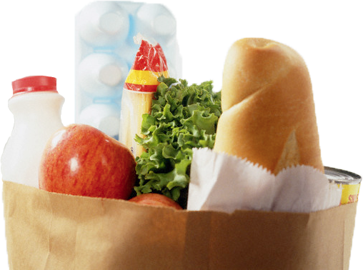
List Example: Grocery List
You are getting ready to head to the grocery store to get some much needed food
In order to organize your trip and to reduce the number of impulse buys, you decide to make a grocery list

Slide 29
List Example: Grocery List
Inputs:
3 items for grocery list
Process:
Store groceries using list data structure
Output:
Final grocery list

Slide 30
Grocery List Code
MAX_GROC = 3
def main():
print("Welcome to the Grocery Manager 1.0")
groceryList = [] # initialize list
# get grocery items from the user
count = 0
while count < MAX_GROC:
item = input("Please enter an item: ")
groceryList.append(item)
count += 1
main()

Slide 31
Grocery List Code
MAX_GROC = 3
def main():
print("Welcome to the Grocery Manager 1.0")
groceryList = [] # initialize list
# get grocery items from the user
count = 0
while count < MAX_GROC:
item = input("Please enter an item: ")
groceryList.append(item)
count += 1
main()
Is there a way to do this without using count? How else could we keep track of how long the list is?

Slide 32
Grocery List Code
MAX_GROC = 3
def main():
print("Welcome to the Grocery Manager 1.0")
groceryList = [] # initialize list
# get grocery items from the user
while len(groceryList) < MAX_GROC:
item = input("Please enter an item: ")
groceryList.append(item)
main()
This works just as well as count, but we don’t need to keep track of the size ourselves!

Slide 33
Iterating Over a List
Now that we have our grocery list, how do we iterate over each element of the list and print out its contents?
Hint: Use a while loop and the len() function!
index = 0
while index < len(groceryList):
print( ??? )
index += 1
groceryList[index]

Slide 34
Membership “in” Operator

Slide 35
Types of Operators in Python
Arithmetic Operators
Assignment Operators
Comparison Operators
Logical Operators
Membership Operators
Bitwise Operators
Identity Operators
what we’re covering now

Slide 36
Membership Operator
The membership operator is very powerful
What do you think this code does?
hounds = ["Ibizan", "Afghan", "Serbian", "Bassett"]
guess = input("Please enter a dog: ")
while guess not in hounds:
print("You guessed wrong!")
guess = input("Guess again: ")
Runs until the user guesses a dog in the list

Slide 37
Membership “in” Operator
Syntax:
element in sequence
Checks to see if element exists in sequence
Evaluates to either True or False
Use it together with while, if, or elif
Can also use not in to test for absence
element to look for
“in” keyword
may be a list or a string

Slide 38
Time for…
LIVECODING!!!

Slide 39
Livecoding: Updated Grocery List
Let’s update our grocery list program to allow as many items as the user wants, using a while loop and a sentinel value of “STOP”
Print out the grocery list (item by item) at the end
You will need to use:
At least one while loop (a sentinel loop)
Conditionals
A single list

Slide 40
Daily emacs Shortcut
Meta
(Remember, either hold Alt, or hit Esc)
Meta + <
Moves cursor to the very front/top of the file
Meta + >
Moves cursor to the very end/bottom of the file

Slide 41
Announcements
HW 3 is out on Blackboard now
Complete the Academic Integrity Quiz to see it
Due by Friday (Sept 29th) at 8:59:59 PM
Pre Lab 5 Quiz will come out Friday @ 10 AM
Must be completed by 10 AM Monday morning

Slide 42
Image Sources
Grocery bag (adapted from):
https://www.flickr.com/photos/77106971@N00/1420127033
Sticky note:
https://www.flickr.com/photos/winning-information/2325865367
Checklist:
https://pixabay.com/p-1316848/

